Slide 1
Atlassian Plugin Development KT
An Overview

Slide 2
Topics
Conceptual Overview of JIRA Plugins / SDK
Logical Deployment Architecture
Introduction to Plugins, Gadgets
Atlassian Plugin Architecture
Current List of Custom developed plugins
Hands-On Demo
Setting up the Development Environment (Hands-On)
Git Setup (Hands-On)
Atlassian SDK Best Practices
On-Going Tasks
Salesforce Integration
Innotas Integration
Qmetry Gadgets
Metrics Gadgets

Slide 3
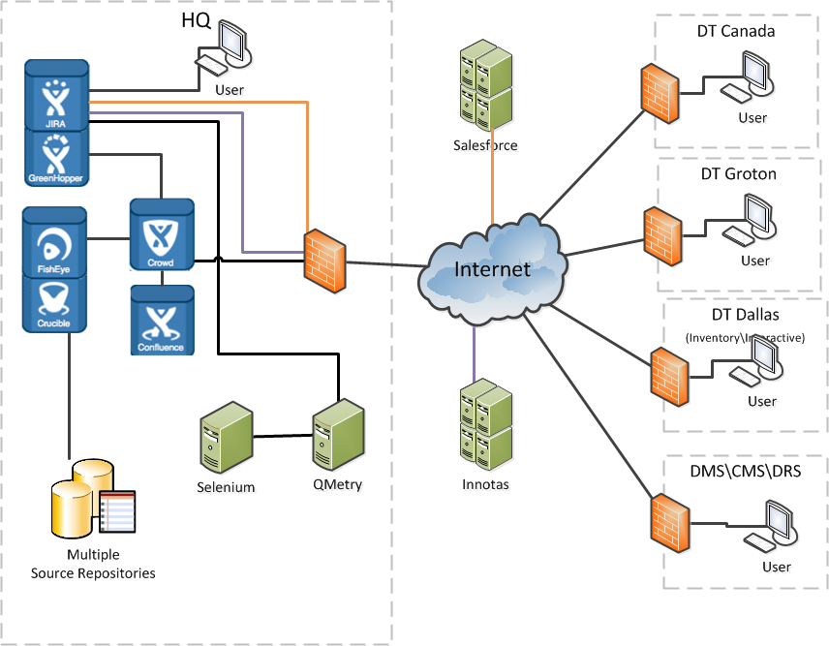
JIRA – DT Deployment Architecture (Logical)
JIRA

Slide 4
JIRA Gadgets / Plugins
Used to extend the capabilities of JIRA
Atlassian SDK provides a framework to develop, package and deploy Plugins
Around 34 different plugin types can be developed
Custom Plugins Developed so far
16 Metrics Gadgets
Innotas Integration
QMetry Gadgets
Plugin purchased from Marketplace
Salesforce plugin by Go2Group

Slide 5
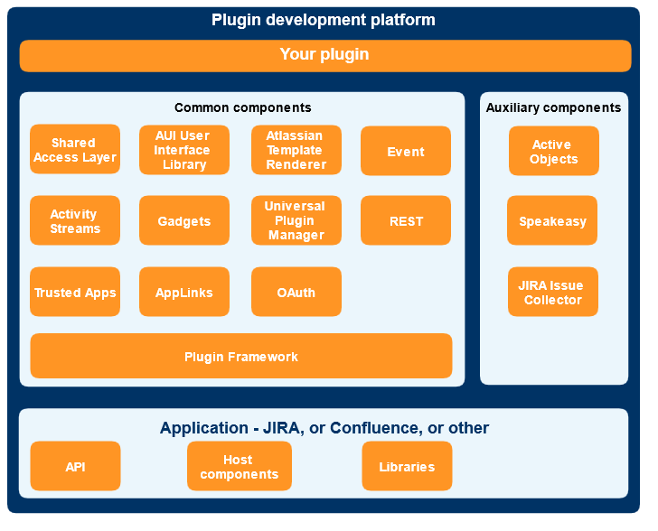
Atlassian Plugin Architecture

Slide 6

Plugin - Data Flow
Custom-made Components
Built-in Components
Browser (UI)
REST Module
Plugin / Gadget
OAuth
JIRA, GH Application
API
JIRA DB
Notes:
To emphasize on the data-flow aspects, an over-simplified representation of the architecture is shown here.

Slide 7
Plugin Data Flow – Examples
Qmetry Gadget ( HTML - Ajax)
Custom REST API (Java – plugin framework)
QMetry Service Client Stub – wsdl2java – axis 1.4
QMetryServices (SOAP)
Jira Metrics Gadget ( HTML - Ajax)
Custom REST API (Java – plugin framework)
JIRA DB
Innotas UI (Velocity Template)
Custom REST API (Java – Plugin Framework)
Innotas Service Client Stub – wsdl2java – axis 1.4
Innotas Services (SOAP)

Slide 8
Gadget Development Steps
Develop REST Module to serve data (Java classes implement the data collection logic)
1
Develop the Gadget Specifications (Gadget XML defines the gadget’s UI)
2
Package the REST Module & Gadget as a plugin (Atlassian-plugin.xml & pom.xml define the plugin config and dependencies)
3

Slide 9
Best Practices
A few best practices to follow:
Make full use of Atlassian-SDK to compile, package and deploy a plugin.
Always package REST APIs separate from the UI implementations
Only Utilize Jira REST or Java APIs to access JIRA data. DONOT directly access/update the DB tables
When a custom table is required for implementation, Create/Select/Update only using ActiveObjects
For more Best Practices refer :
https://developer.atlassian.com/display/DOCS/Best+Practices
REST API Best Practices

Slide 10
Reference

Slide 11
References
Atlassian / Jira
Jira Plugin Guide
Jira Plugin Tutorials
Atlassian Java & REST API Reference
Atlassian Developer Forum
Writing Atlassian Gadget
Develping REST plugin
Atlassian UI Framework
Atlassian Tutorials - Source Repository
JQPlot (used for plotting graphs)
Innotas Web Service Documentation

Slide 12
Atlassian Project Artifacts and Links
Project Wiki Pages
Source (Git) Repository
Jira Clone Instance
Jira Prod Instance
Jira Project
QMetry Site
Innotas Sandbox
SalesForce Sandbox
For login credentials, pl. reach out to Vikas Basra or the current Jira System Administrator

